Slide 1

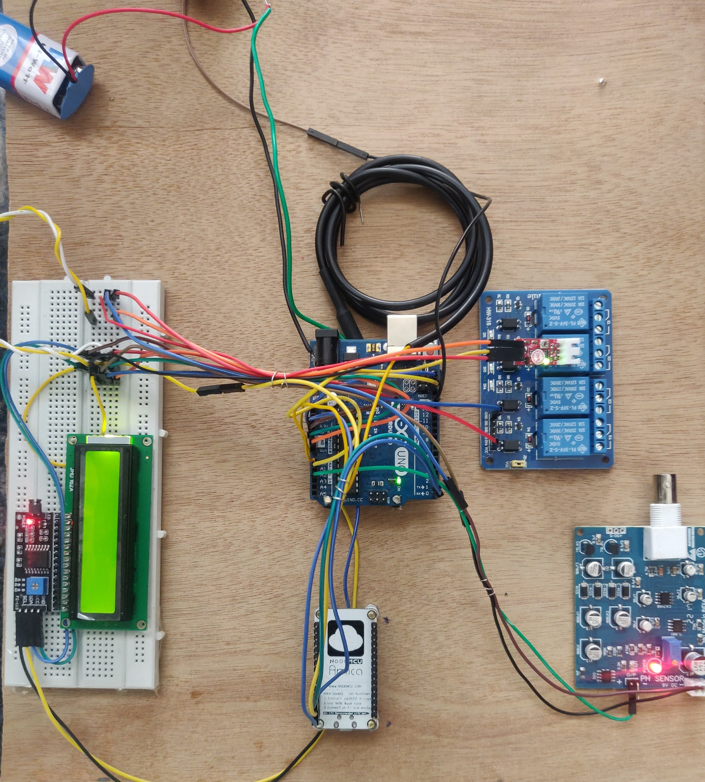






Innovative Projects- Arduino Using Embedded ‘C’ (CSE1002)
WASTE WATER MANAGEMENT SYSTEM IN VILLAGES
Waste water management project aims to design and develop a system that can monitor and manage the quality of waste water using an Arduino microcontroller. The foremost aim of this project includes the estimation of water quality parameters like Turbidity, Temperature that helps to identify the deviations in parameters
IPA – (435)
26TH – 27TH
MAY 2023
KIRAN TB
20221CSE0686
SHUBHAM KUMAR
20221CSE0721
GURUPADESHWAR
20221CSE0672
ROHAN S NAIK
20221CCS0108
UMESH METHRE
20221CIT0147
DR.PREETHI
COMPUTER SCIENCE DEPARTMENT

